Slide 1



Telecom Churn
Why customers leave!

Slide 2




Behind the project
Ahmed Anwar
Muhannad Mahfouz
Esraa Soliman
Ibrahim Saeed
Tasneem Shaaban
Instructor: Eng Abdelrahman Ashour

Slide 3



Introduction
Imagine a customer who relies on their telecom service every day making calls, paying bills, staying connected.
Then one day, they decide to leave for a competitor !
Every lost customer means lost revenue and higher costs to win new ones.

Slide 4



The challenge
High customer churn in the telecom sector causes major revenue losses and raises the cost of acquiring new customers.
Strong competition
Service quality issues
Pricing and contracts
Customer support
problems
At-risk customers

Slide 5






Objectives
Identify churn drivers: analyze customer characteristics, contracts, and service usage to reveal why customers leave.
Support decision-making: build an interactive dashboard to track churn trends and guide retention strategies.
Quantify business impact: measure revenue loss caused by churn and highlight the most affected segments.

Slide 6




Key Questions
What is the churn rate and how does it change over time?
What are the main reasons behind churn ?
What is the financial cost and who are the high-value customers to retain ?
Which customer segments are most at risk of leaving ?
How do pricing, contracts, and services influence churn ?

Slide 7




About Dataset
This dataset includes telecom customer information such as demographics, service subscriptions, contract types, usage patterns, charges, and churn status. It covers a large number of customers over recent periods.

Slide 8








Methodology & Data preparation
Data Gathering Collect telecom customer churn data.
Cleaning & prep Fix errors, using
data warehouse (silver/bronze/gold)
Modeling & linking Build relationships, structured datasets.
Visualization Create interactive dashboards & visuals.
Analysis & KPIs Calculate metrics, extract insights.

Slide 9


Dashboards Overview
Power BI Dashboards Analysis delivers interactive insights for the Telecom Churn project, covering Overview, Churn Analysis, Customer Segmentation, Service Usage, and Customer Demographics, enabling stakeholders to make informed, data-driven decisions.

Slide 10

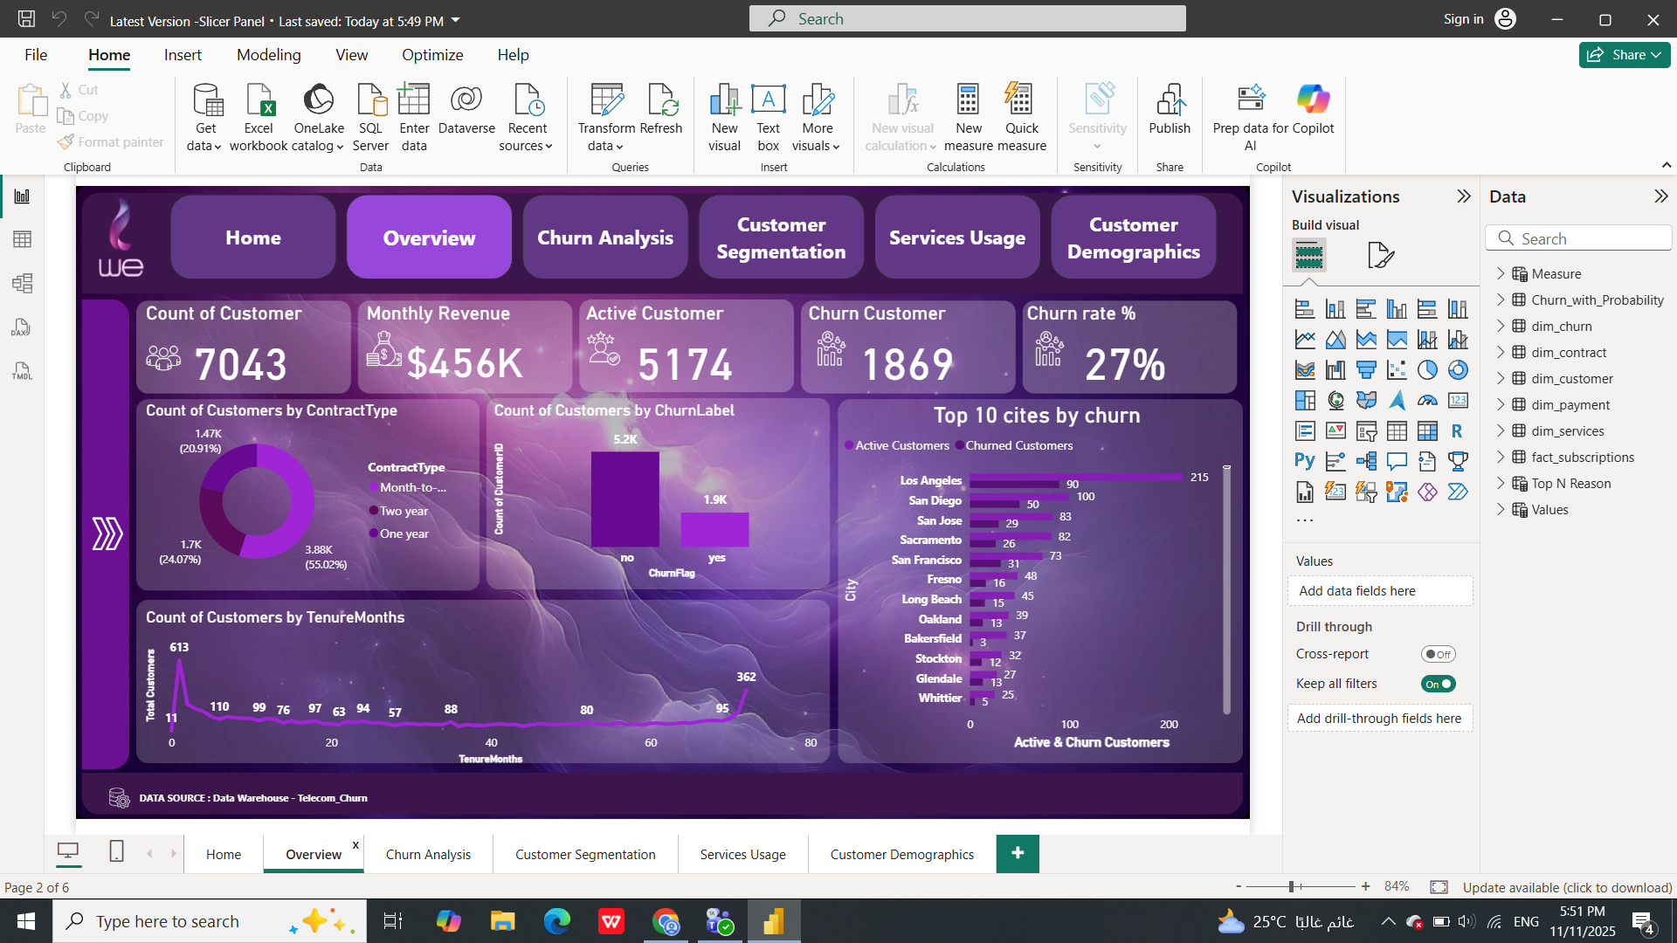
Overview

Slide 11

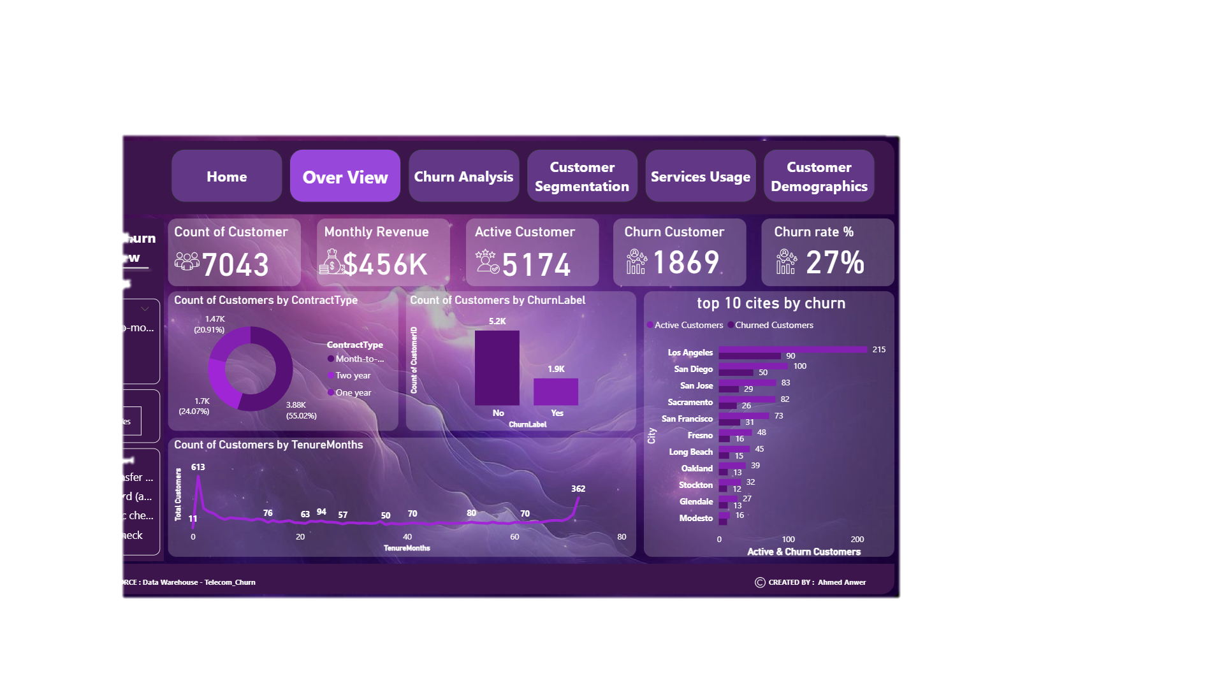
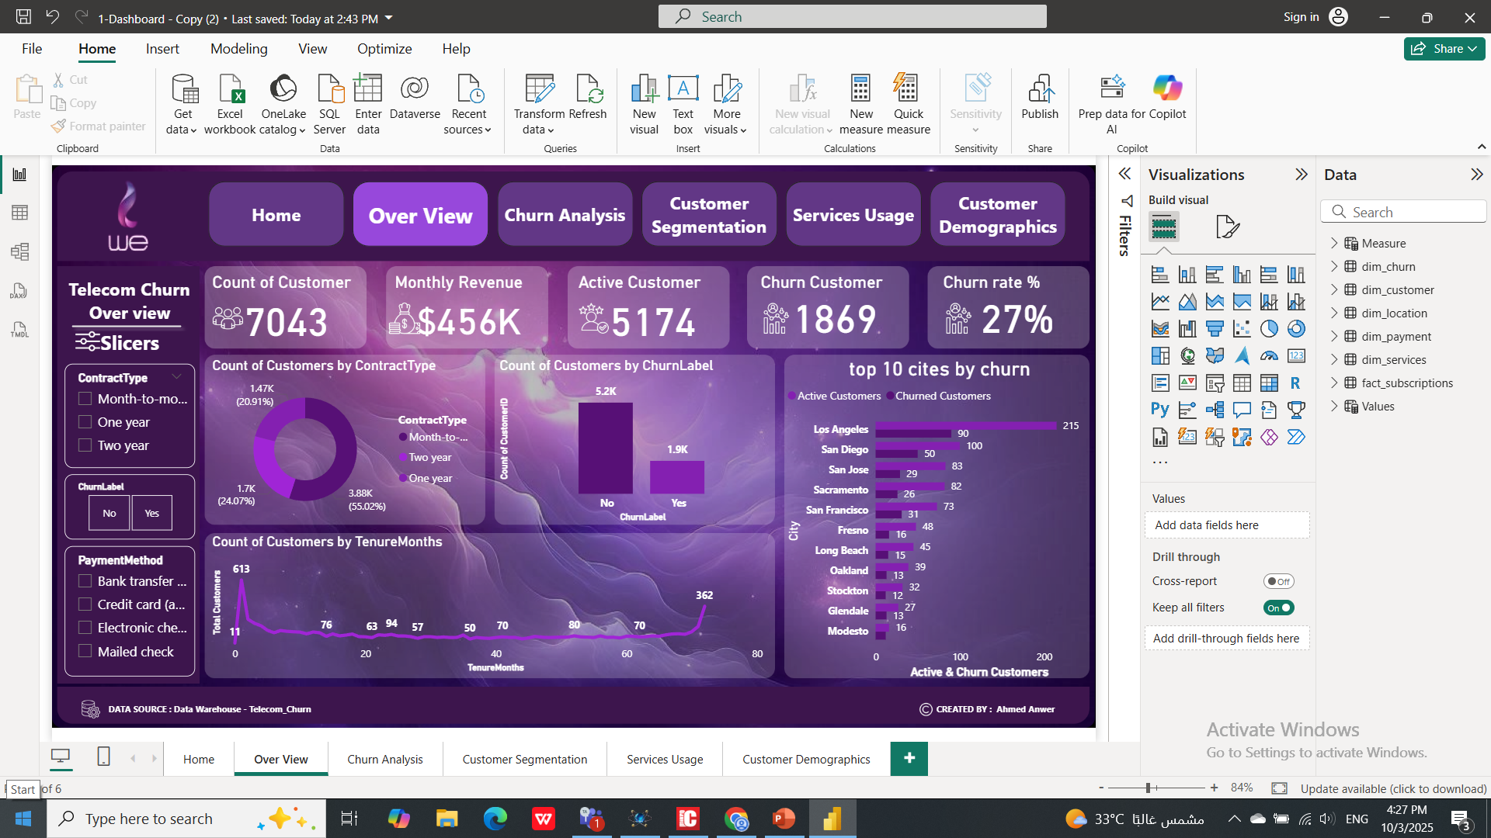

Insights
Indicating a significant portion of users leaving the service.
Most customers are on month-to-month contracts (55%), showing flexibility but also higher churn risk.
Majority of churned users have shorter tenure months, meaning early-stage customer loss is high.

Slide 12


Insights
Top churn cities (Los Angeles, San Diego) reflect regional retention challenges and competitive market pressure.
Recommended
Introduce loyalty or long-term contract incentives to reduce churn among month-to-month users.
Focus retention campaigns on early-stage customers and high-churn cities to improve customer lifetime value.

Slide 13

Churn Analysis

Slide 14
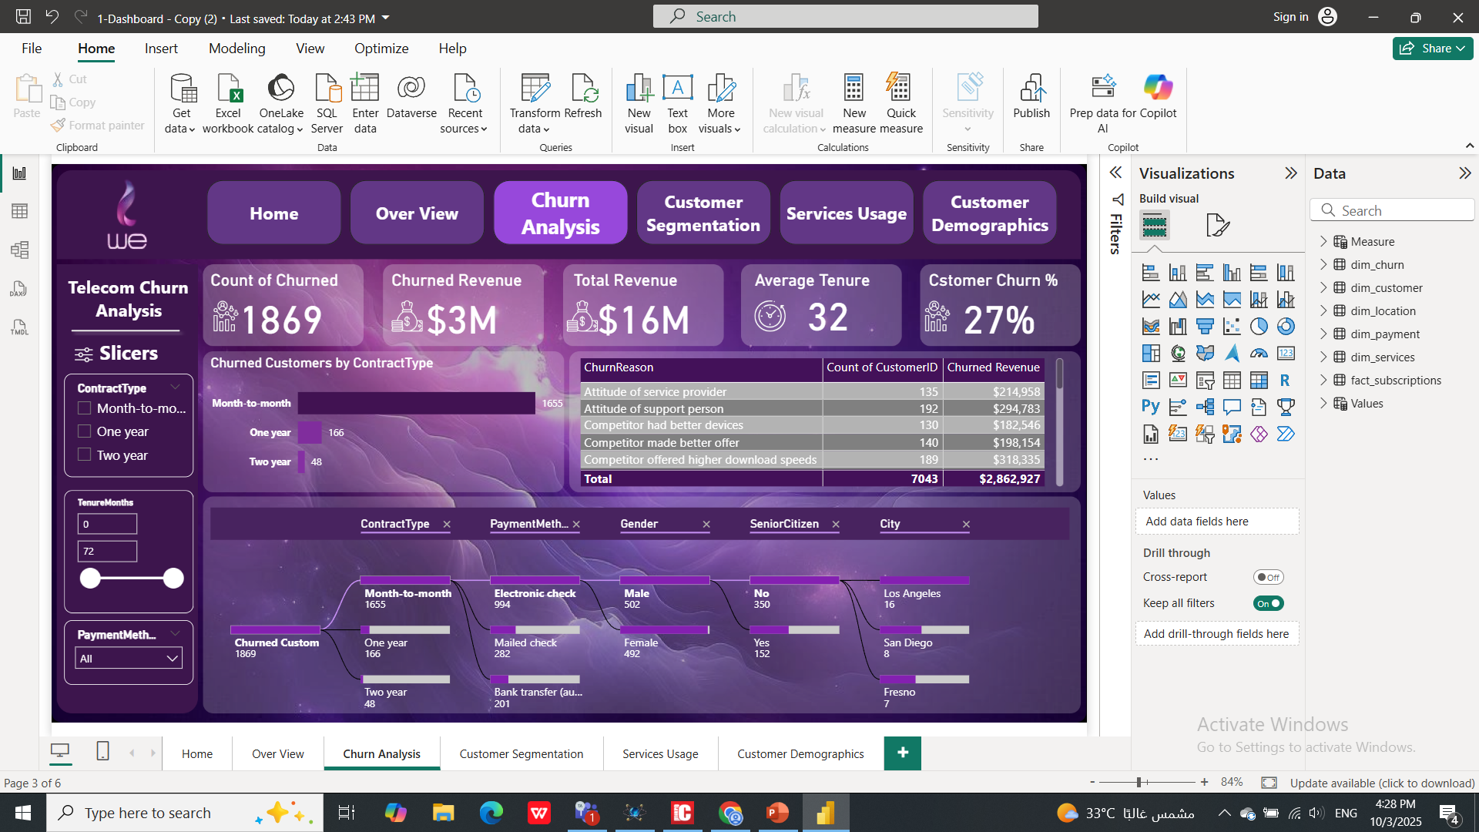
Insights
Average customer tenure is 32 months, meaning customers usually stay for some time before deciding to leave.

Slide 15
Insights
Many churned customers use electronic check payments, which may reflect lower digital engagement or convenience issues.
Male customers and non-senior citizens show slightly higher churn tendencies.
Most churned customers are on month-
to-month contracts, short-term contracts make it easier for customers to leave.

Slide 16
Recommended
Improve customer support experience through better training and faster issue resolution, ensure competitive offers to retain customers attracted by faster competitors.
Promote long-term plans by adding benefits or discounts to reduce churn from monthly contracts.

Slide 17
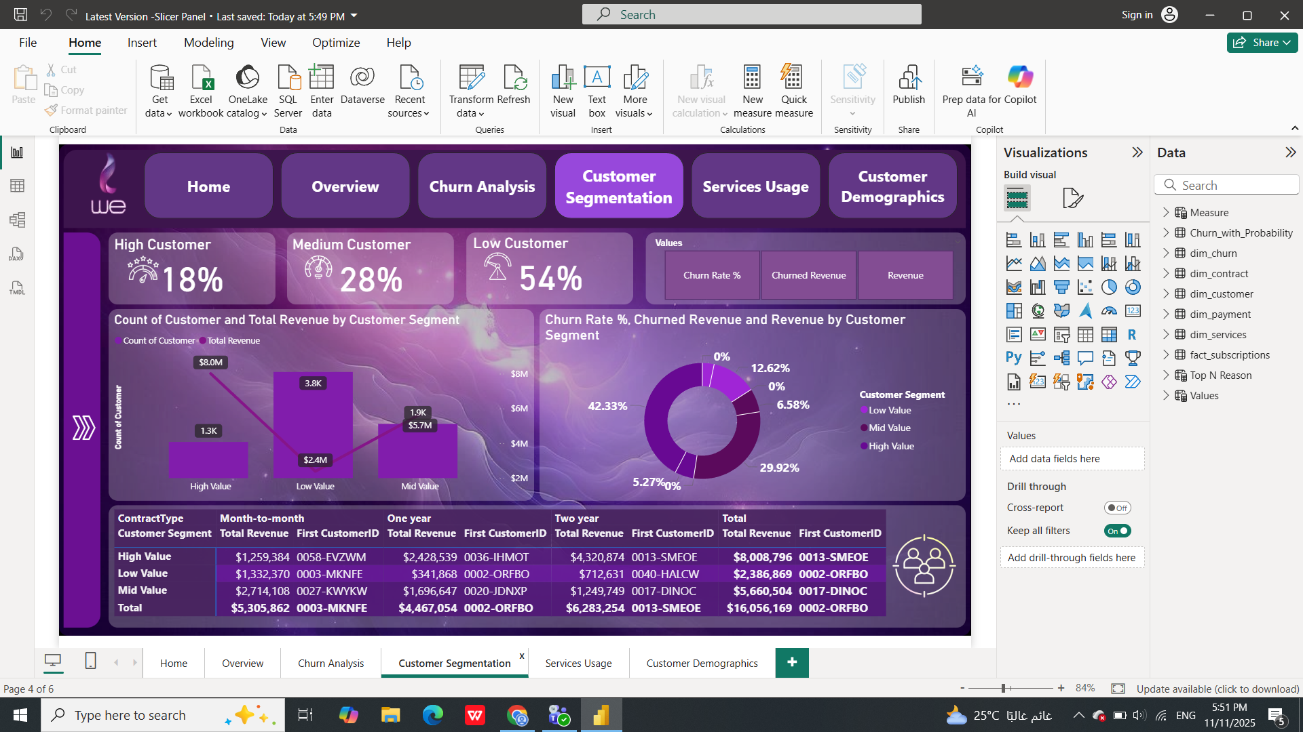
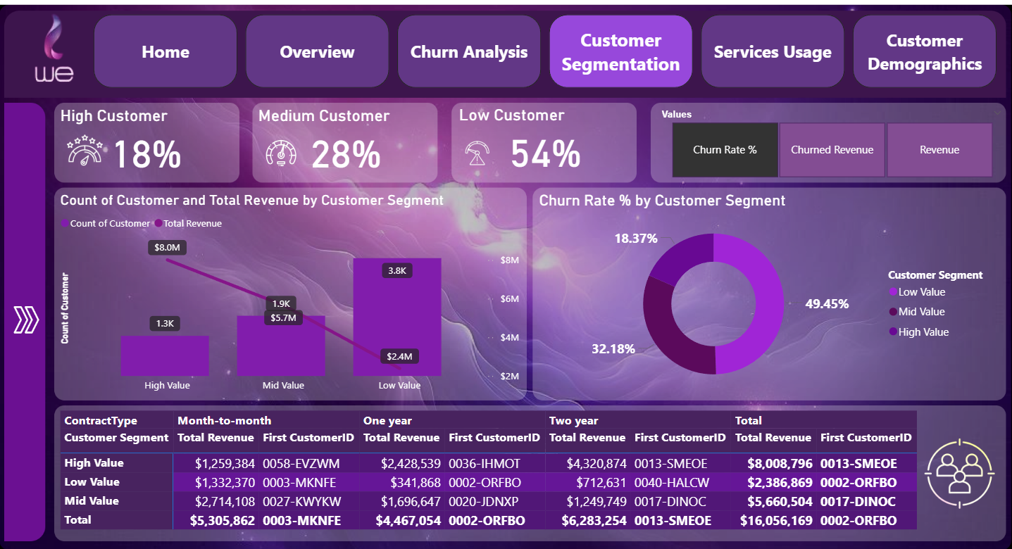
Customer
Segmentation

Slide 18
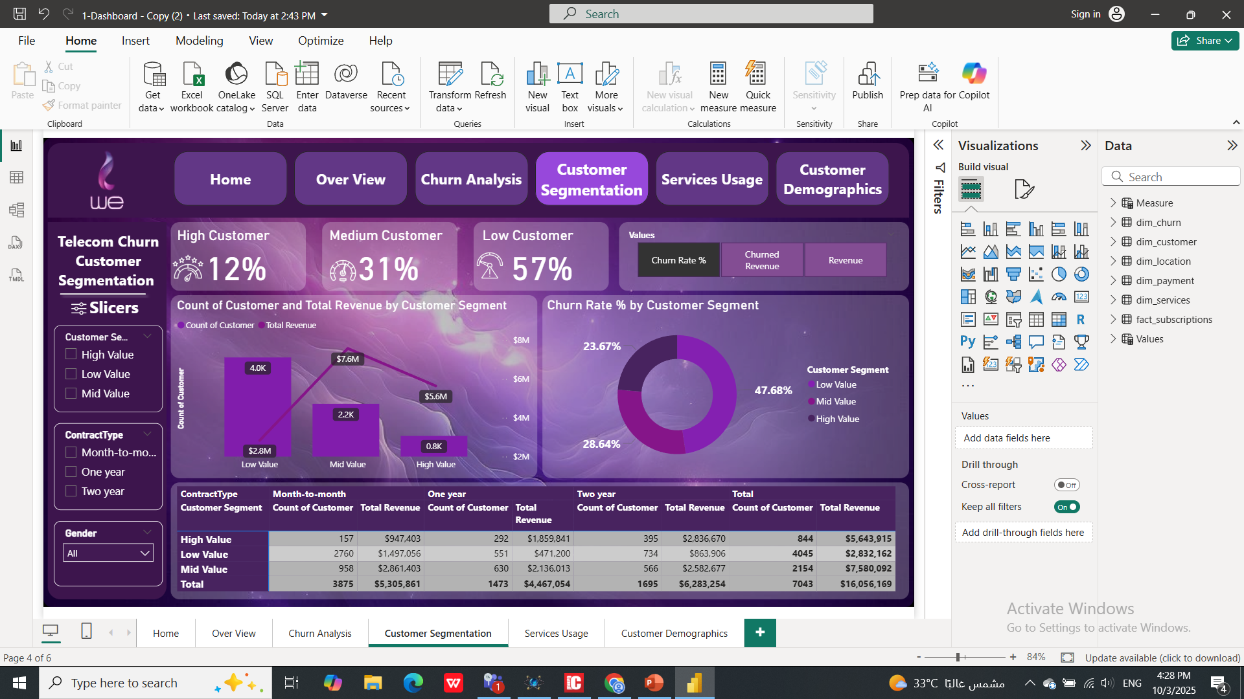
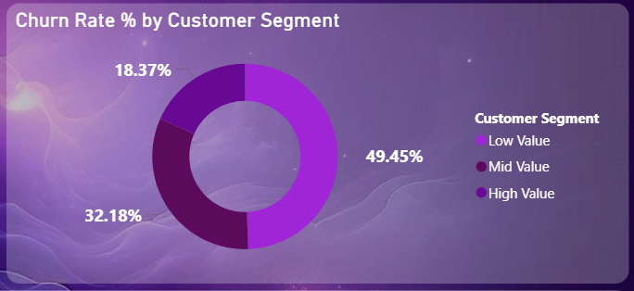
Insights
The Low Value segment forms the majority (57%) but contributes only $2.8M, showing low profitability.
Mid and High Value customers together (43%) generate most of the revenue, $7.6M and $5.6M respectively, making them the company’s most valuable segments.
Churn Rate is highest among Low Value (49.82%), followed by Mid Value (32.33%), and lowest for High Value (18.62%), indicating that higher-value customers are more loyal.

Slide 19
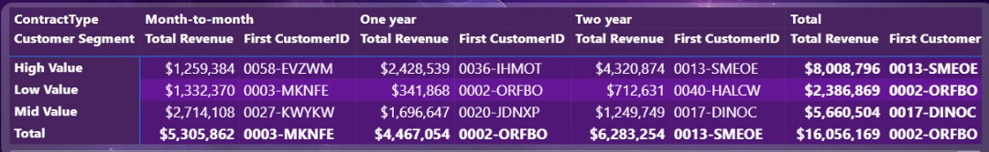
Insights
C
Most churned customers have month-to-month contracts, especially in the Low Value segment (2,760 customers).
Two-year contracts show the lowest churn and highest revenue, confirming that longer commitments reduce customer loss.
C
C
The total revenue across all segments equals $16M, consistent with overall churn analysis.

Slide 20
Recommended
Target Low and Mid Value customers with personalized retention programs (discounts, add-ons, loyalty points) to cut high churn.
Maintain and reward High Value customers through exclusive offers and premium support.
Encourage long-term contracts via incentives or bundled plans to build stability and lower churn.

Slide 21
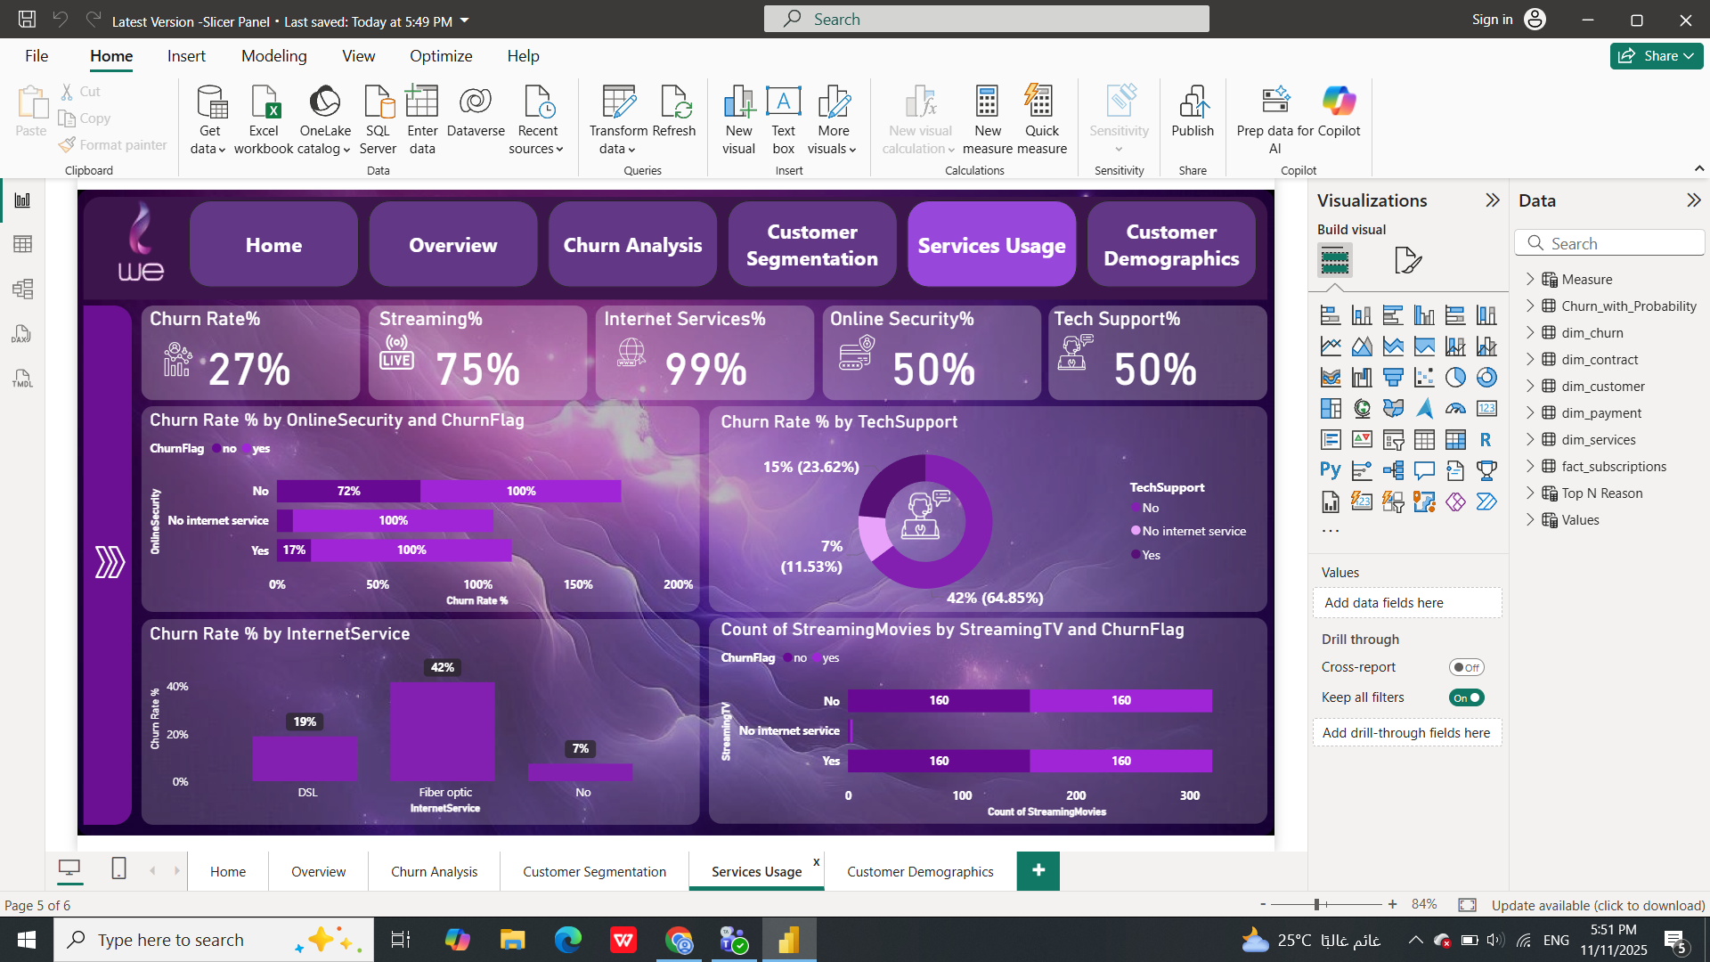
Services Usage

Slide 22
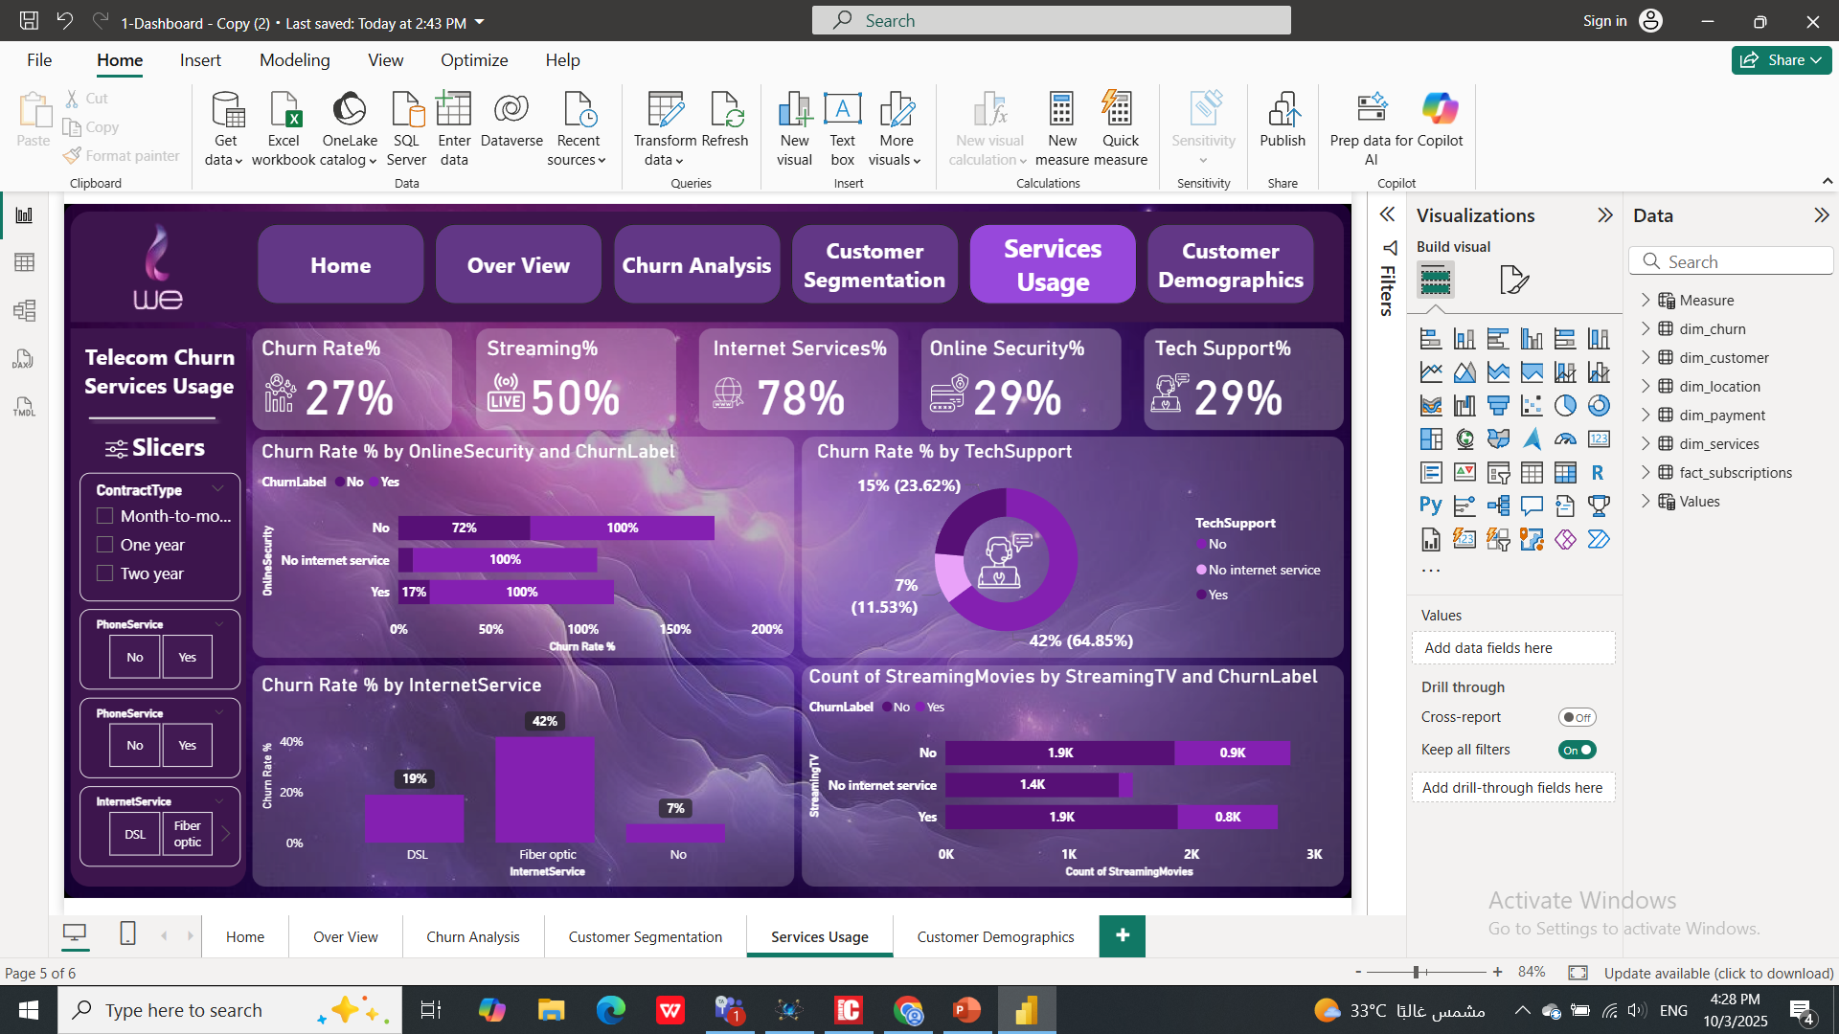
Insights
Customers who utilize Tech Support exhibit a high churn rate of 42%, suggesting that interacting with support is a major pre-cursor or consequence of a poor overall experience.
The Fiber Optic internet type has the highest churn rate at a critical 42%, significantly surpassing DSL's 19% churn and pointing to systemic issues with this specific product line.

Slide 23
Insights
This service is the strongest safeguard against churn, drastically reducing the churn rate from 72% (for those without it) down to just 17% for those who subscribe.
Internet service is the most widely adopted product (78% penetration), while the volume of Streaming Movies Watched is not a differentiator between churned and non-churned customers.

Slide 24
Recommended
Mandate Online Security: Immediately bundle Online Security with Fiber Optic to stabilize the highest-risk revenue base.
Fix Fiber Quality: Launch an urgent task force to resolve systemic issues in the Fiber Optic network causing 42% churn.
Redesign Tech Support: Overhaul the support process to improve First-Contact Resolution (FCR), turning the channel into a service stabilizer.

Slide 25
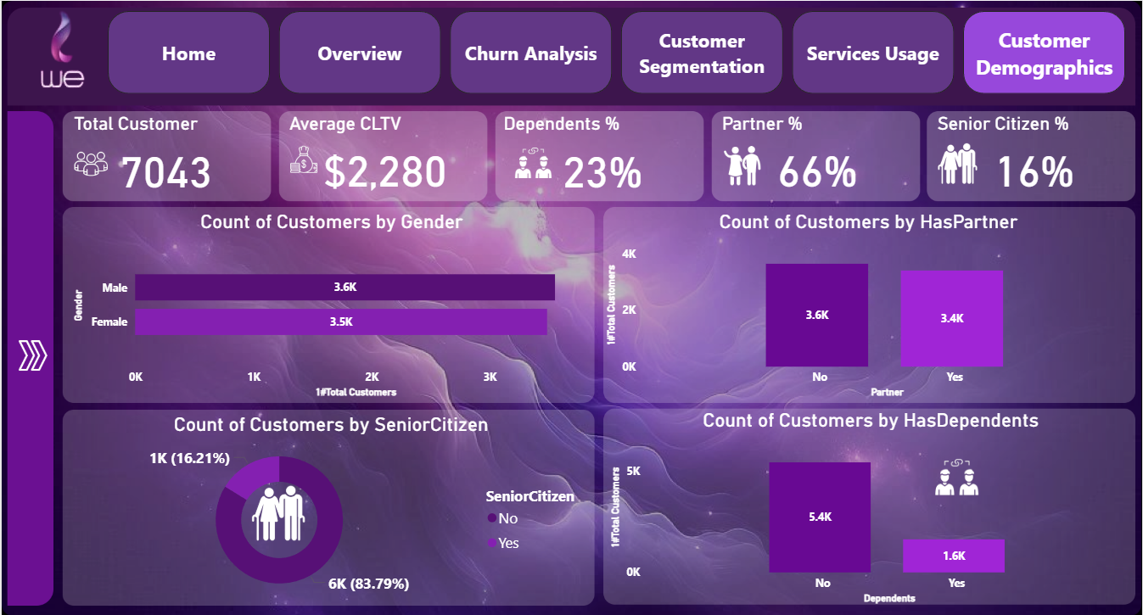
Customer
Demographics

Slide 26
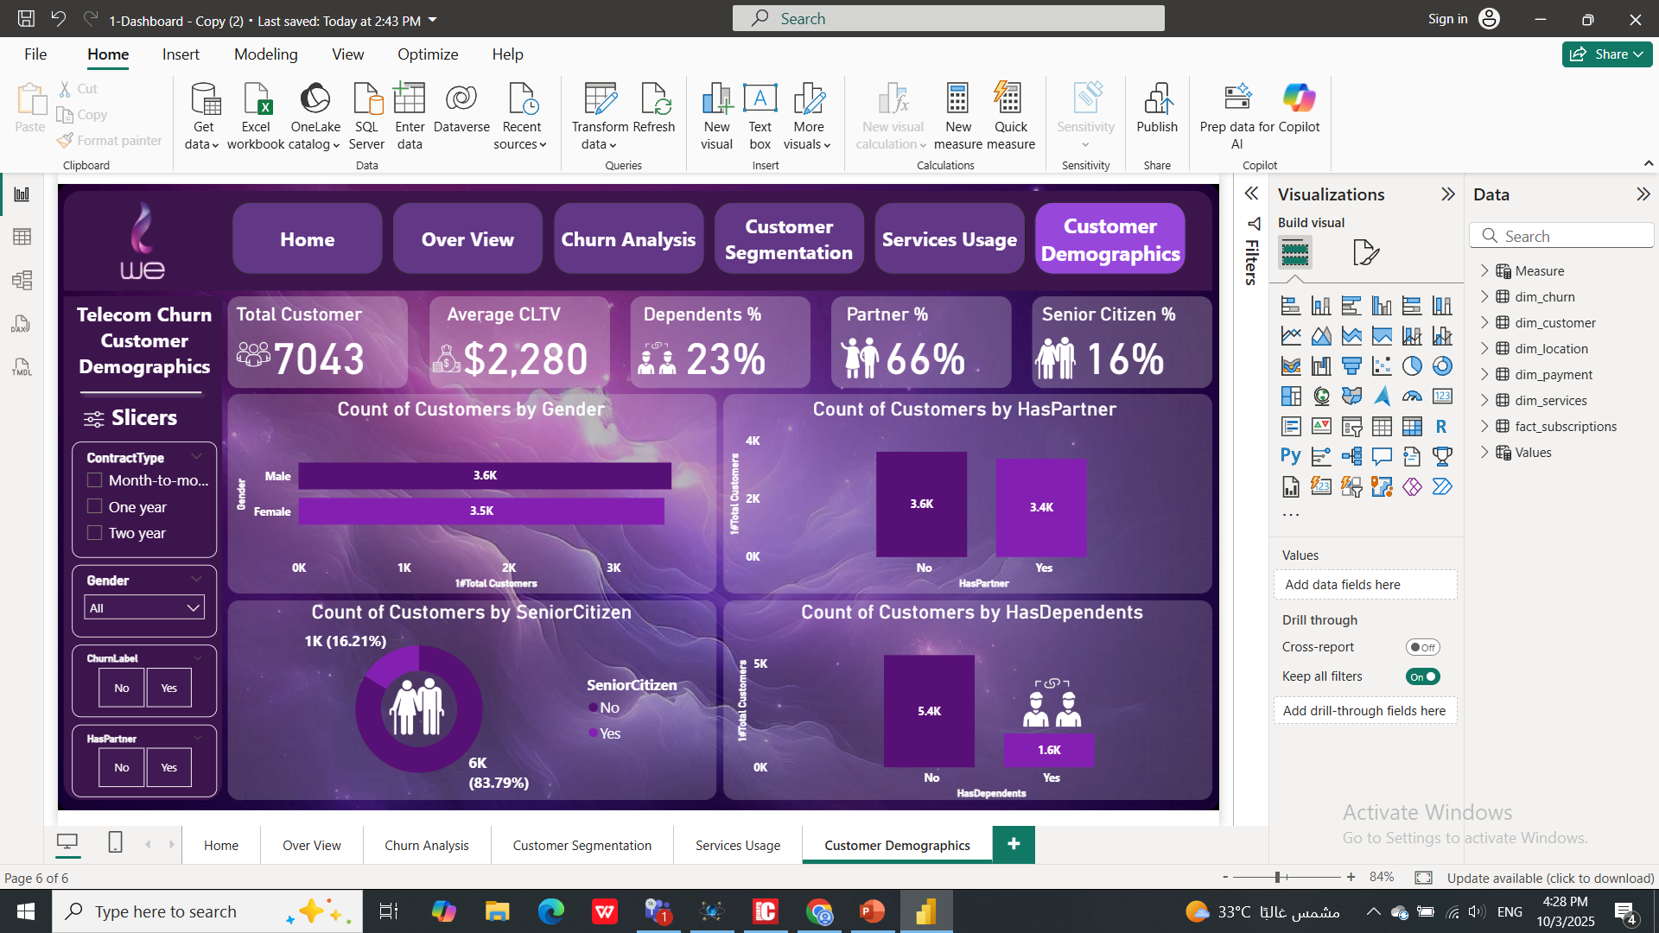
Insights
34% of customers do not have a Partner; this large single-customer segment represents the most volatile group in terms of churn risk, despite being smaller than the Partner segment.
Gender is the least relevant demographic factor for churn, as the customer count for Male (3.6K) is almost identical to Female (3.5K), showing no correlation with overall churn behavior.

Slide 27
Insights
The Senior Citizen segment (16.21%) is the second smallest group; while they are stable, they likely have the lowest revenue impact due to low Average CLTV and volume.
The group with Dependents (1.6K) is the smallest segment, this group is generally stable, its size means its low churn rate has a minimal positive impact on the overall retention rate.

Slide 28
Recommended
Launch short-term digital "Engagement & Value" plans focused on the young, non-partnered segment to directly mitigate their high churn risk.
Introduce bundled, premium Partner/Family packages to increase the low Average CLTV of loyal, stable multi-person households.
Move stable, low-value Senior Citizens to low-cost self-service support options to maintain loyalty and reduce service operational costs.

Slide 29







Link
Telecom churn analysis

